Slide 1
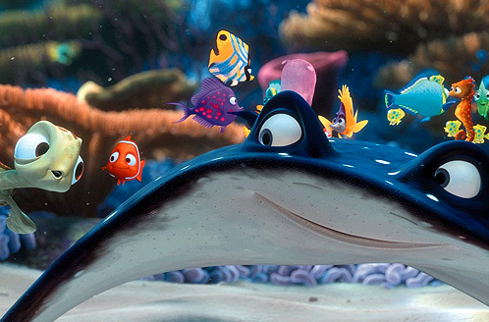
Collaboration: Don’t Get Lost in the Sea

Slide 2
Our Goals Today will be to…
  Define the collaborative Process.
  Show how the collaborative process benefits students and staff.

Slide 3
What is Collaboration?

Slide 4

Schools are Busy Places With Many Distractions
Curriculum
Time
Testing
Notes:
You don’t have time: Add different levels labled to block out the environment

Slide 5
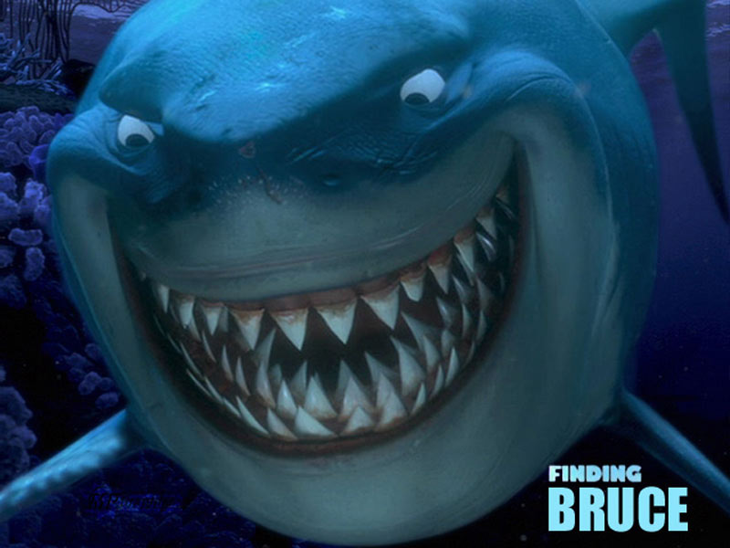
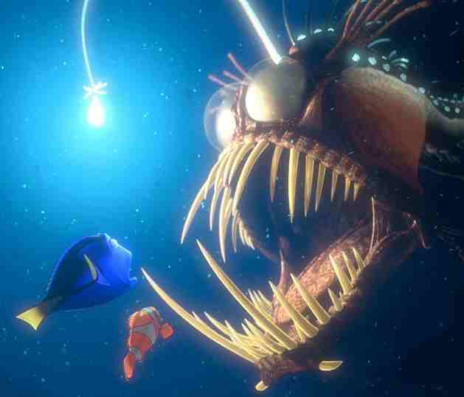
What we are not...
...looking to overpower you and have you do things OUR way!!
We want to support your curriculum.

Slide 6
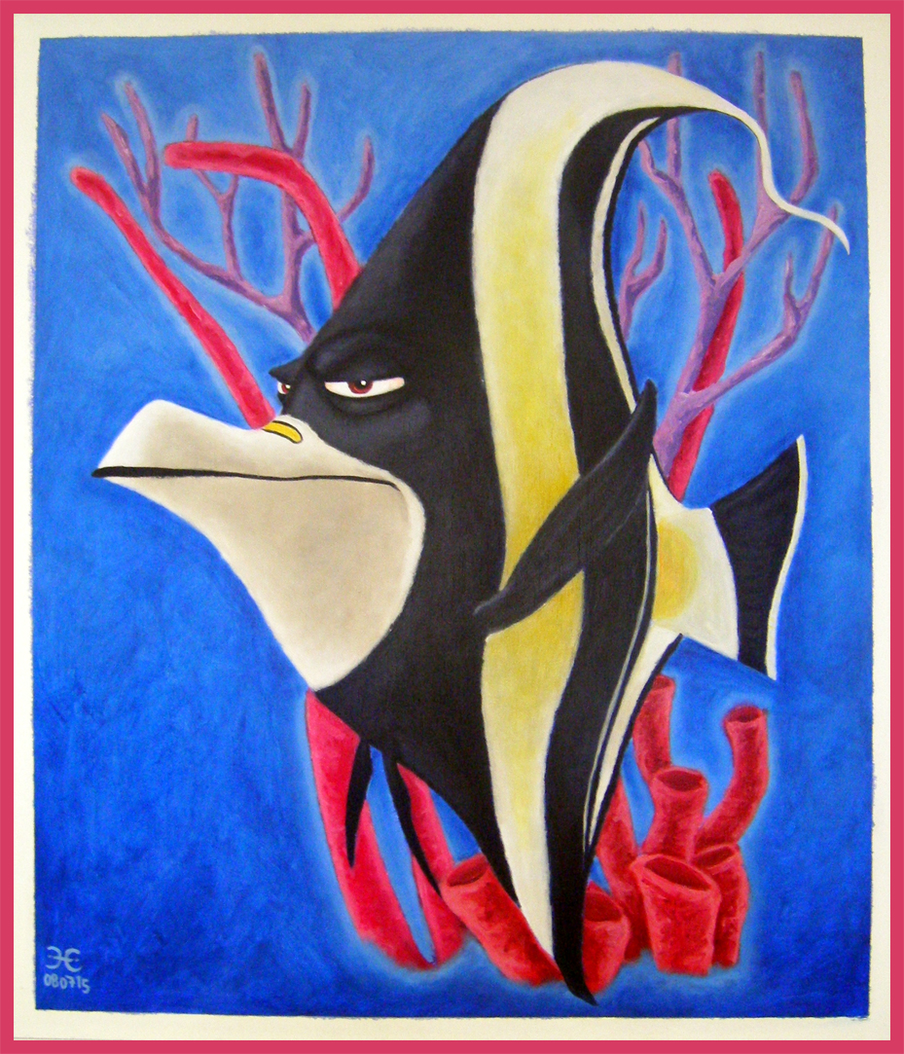
What we are not...
Gill - the veteran know-it-all who always does things the same way.
We are focused on empowering learners for the 21st century and always are looking for new ideas, resources, and inquiry opportunities.

Slide 7
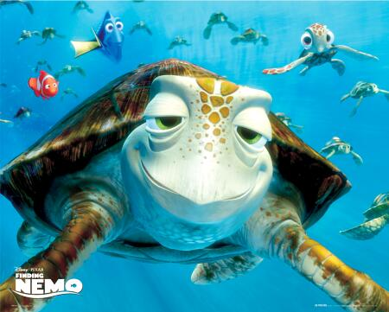
What we are not...
Crush - The laid-back turtle.....
just chillin' in the library doing
our own thing.
.
We want to make connections with your curriculum. We want to be a part of planning, supporting and implementing content and literacy objectives

Slide 8
Wrap-Up: Together, We Swim Together
Together!
We swim together!
Collaboration is the secret to our success
Together!
We swim in harmony

Slide 9
Resources
AASL. Empowering Learners. Chicago, IL: American Association of School Librarians, 2009. Print.
AASL. Standards for the 21st Century Learner in Action. Chicago, IL: American Association of School Librarians, 2009. Print.
Frazier, Dawn. “School Library Media Collaborations: Benefits and Barriers.” Library Media Connection. 29 (2010); 34-36. Academic Search Complete. EBSCO. Web 5 Feb. 2011
Harvey, Carl. “The Teacher’s Take on the School Library Program.” School Library Monthly 26 (2009) : 45-47. Academic Search Complete. EBSCO. Web. 5 Feb. 2011
"Library Media Handbook." HCPSS. 2011. Web. 4 February 2011.
Moreillon, Judi. “Show Them What We Do: Strategies for Collaborative Teaching.” 21st –Century Learning in School Libraries Ed. Kristin Fontichiaro, Santa Barbara, CA: ABC-CLIO, Inc., 2009. 218-220. Print

Slide 10
Outline of Presentation
  Our objectives for the session
    Define the Collaborative Process.
    Show how the collaborative process benefits students and staff.
  Common barriers for collaboration Obj. 1
        tests
        time
        curriculum
  Tests- "Fish for Facts"
        Please read the fish you catch and discuss with your table.
  Time- What we are not
        "We are not" slides
        We value your time!
  Curriculum- What Collaboration Looks like
        One Teaching One Supporting: Liz
        Center Teaching:Liz
        Parallel Teaching:Jen
        Alternate Teaching: Kathy
        Team Teaching:Jen
        Team Teaching: Kathy
  Next Steps
        Raffle/ Let us help with that lesson you dislike, can't get to, want to jazz up: Kathy
        Share half sheet of resources/ support: Liz
        Evaluation Piece: Jen

